Slide 1
Renewable Energy Utilization EP409, 4th Level course Dept.: Engineering of Power and Electrical Machines 2nd lecture , 3rd May. 2021
Instructor:
Hatim G. Abood
PhD, Electrical Power Engineering
hatim.abood@uodiyala.edu.iq

Slide 2
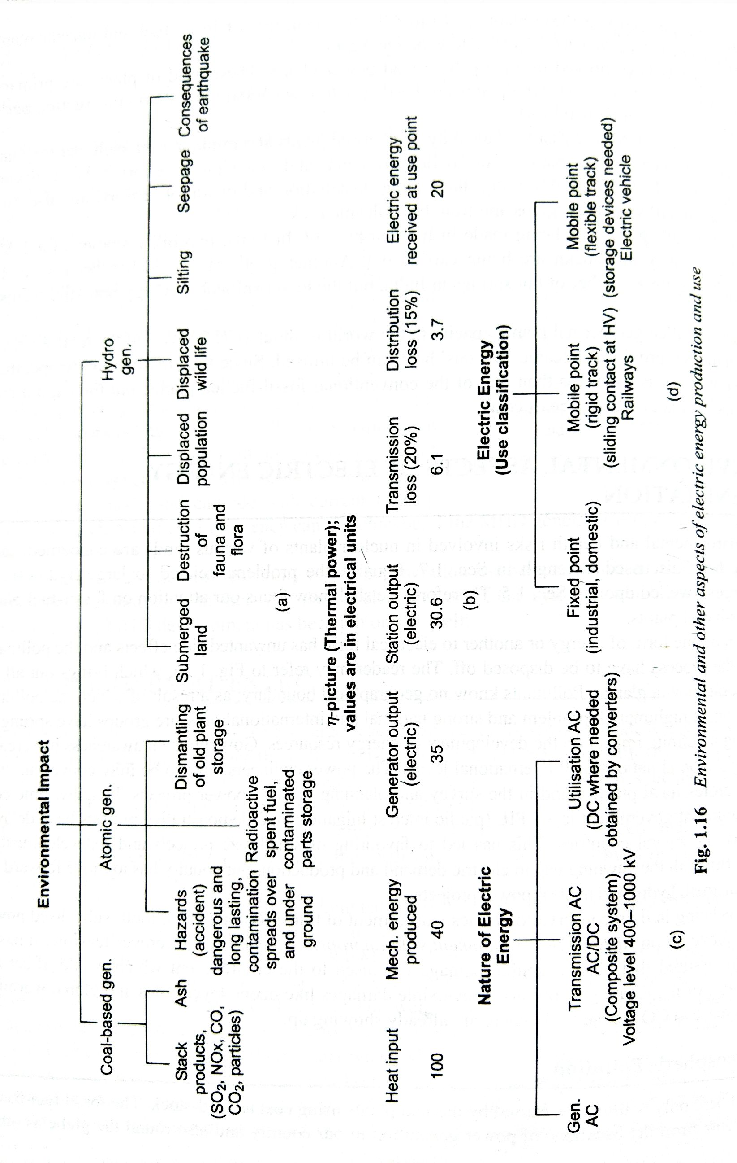

Slide 3
Energy Crisis
1970s energy crisis - caused by the peaking of oil production in major industrial nations (Germany, United States, Canada, etc.) and embargoes from other producers
1973 oil crisis - caused by an OAPEC oil export embargo by many of the major Arab oil-producing states, in response to Western support of Israel during the Yom Kippur War (June War حرب اكتوبر)
1979 oil crisis - caused by the Iranian RevolutionGcprrets.gif
1990 oil price shock - caused by the Gulf War
The 2000–2001 California electricity crisis - Caused by market manipulation by Enron and failed deregulation; resulted in multiple large-scale power outages
Fuel protests in the United Kingdom in 2000 were caused by a rise in the price of crude oil combined with already relatively high taxation on road fuel in the UK.
North American natural gas crisis 2000-2008
2004 Argentine energy crisis
North Korea has had energy shortages for many years.
Zimbabwe has experienced a shortage of energy supplies for many years due to financial mismanagement.
Political riots occurring during the 2007 Burmese anti-government protests were sparked by rising energy prices.

Slide 4
Energy crisis – Cont.
2000s energy crisis - Since 2003, a rise in prices caused by continued global increases in petroleum demand coupled with production stagnation, the falling value of the U.S. dollar, and a myriad of other secondary causes.
2008 Central Asia energy crisis, caused by abnormally cold temperatures and low water levels in an area dependent on hydroelectric power. At the same time the South African President was appeasing fears of a prolonged electricity crisis in South Africa. "Mbeki in pledge on energy crisis". Financial Times. Retrieved 2008-02-10.
In February 2008 the President of Pakistan announced plans to tackle energy shortages that were reaching crisis stage, despite having significant hydrocarbon reserves,. In April 2010, the Pakistani government announced the Pakistan national energy policy, which extended the official weekend and banned neon lights in response to a growing electricity shortage.[5]
South African electrical crisis. The South African crisis led to large price rises for platinum in February 2008 and reduced gold production.
China experienced severe energy shortages towards the end of 2005 and again in early 2008. During the latter crisis they suffered severe damage to power networks along with diesel and coal shortages. Supplies of electricity in Guangdong province, the manufacturing hub of China, are predicted to fall short by an estimated 10 GW. In 2011 China was forecast to have a second quarter electrical power deficit of 44.85 - 49.85 GW.
Nepal experienced severe energy crisis in 2015 when India created an economic blockade to Nepal. Nepal faced the shortages of various kinds of petroleum products and food materials which affected severely on Nepal's economy.
The Gaza electricity crisis is a result of the tensions between Hamas, who rules the Gaza Strip, and the Palestinian Authority/Fatah, who rules the West Bank over custom tax revenue, funding of the Gaza Strip, and political authority. Residents receive electricity for a few hours a day on a rolling blackout schedule.

Slide 5
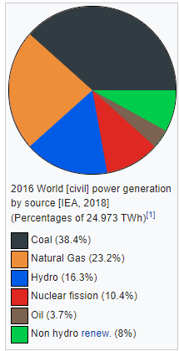
Renewable energy is energy that is collected from renewable resources, which are naturally replenished on a human timescale, such as sunlight, wind, rain, tides, waves, and geothermal heat.
Renewable energy often provides energy in four important
areas:
electricity generation, air and water heating/cooling,
transportation, and rural (off-grid) energy services.

Slide 6
Based on REN21's 2017 report, renewables contributed 19.3% to humans' global energy consumption and 24.5% to their generation of electricity in 2015 and 2016, respectively. This energy consumption is divided as 8.9% coming from traditional biomass, 4.2% as heat energy (modern biomass, geothermal and solar heat), 3.9% hydro electricity and 2.2% is electricity from wind, solar, geothermal, and biomass. Worldwide investments in renewable technologies amounted to more than US$286 billion in 2015, with countries such as China and the United States heavily investing in wind, hydro, solar and biofuels. Globally, there are an estimated 7.7 million jobs associated with the renewable energy industries, with solar photovoltaics being the largest renewable employer. As of 2015 worldwide, more than half of all new electricity capacity installed was renewable.
Renewable energy resources exist over wide geographical areas, in contrast to other energy sources, which are concentrated in a limited number of countries. Rapid deployment^{[8]} of renewable energy and energy efficiency is resulting in significant energy security, climate change mitigation, and economic benefits. The results of a recent review of the literature concluded that as greenhouse gas (GHG) emitters begin to be held liable for damages resulting from GHG emissions resulting in climate change, a high value for liability mitigation would provide powerful incentives for deployment of renewable energy technologies. In international public opinion surveys there is strong support for promoting renewable sources such as solar power and wind power.

Slide 7
At the national level, at least 30 nations around the world already have renewable energy contributing more than 20 percent of energy supply. National renewable energy markets are projected to continue to grow strongly in the coming decade and beyond. Some places and at least two countries, Iceland and Norway generate all their electricity using renewable energy already, and many other countries have the set a goal to reach 100% renewable energy in the future. For example, in Denmark the government decided to switch the total energy supply (electricity, mobility and heating/cooling) to 100% renewable energy by 2050. At least 47 nations around the world already have over 50 percent of electricity from renewable resources, with Iceland generating all its electrical power from renewable energy though this does not include non-electrical energy (e.g. transport and heating).

Slide 8
While many renewable energy projects are large-scale, renewable technologies are also suited to rural and remote areas and developing countries, where energy is often crucial in human development. Former United Nations Secretary-General Ban Ki-moon has said that renewable energy has the ability to lift the poorest nations to new levels of prosperity. As most of renewables provide electricity, renewable energy deployment is often applied in conjunction with further electrification, which has several benefits: Electricity can be converted to heat (where necessary generating higher temperatures than fossil fuels), can be converted into mechanical energy with high efficiency and is clean at the point of consumption. In addition to that electrification with renewable energy is much more efficient and therefore leads to a significant reduction in primary energy requirements, because most renewables do not have a steam cycle with high losses (fossil power plants usually have losses of 40 to 65%).
Renewable energy systems are rapidly becoming more efficient and cheaper and their share of total energy consumption is increasing. Global installed electricity generating capacity in 2017 was 2.2 TW. Growth in consumption of coal and oil could end by 2020 due to increased uptake of renewables and natural gas.

Slide 9
While many renewable energy projects are large-scale, renewable technologies are also suited to rural and remote areas and developing countries, where energy is often crucial in human development. Former United Nations Secretary-General Ban Ki-moon has said that renewable energy has the ability to lift the poorest nations to new levels of prosperity. As most of renewables provide electricity, renewable energy deployment is often applied in conjunction with further electrification, which has several benefits: Electricity can be converted to heat (where necessary generating higher temperatures than fossil fuels), can be converted into mechanical energy with high efficiency and is clean at the point of consumption. In addition to that electrification with renewable energy is much more efficient and therefore leads to a significant reduction in primary energy requirements, because most renewables do not have a steam cycle with high losses (fossil power plants usually have losses of 40 to 65%).
Renewable energy systems are rapidly becoming more efficient and cheaper and their share of total energy consumption is increasing. Global installed electricity generating capacity in 2017 was 2.2 TW. Growth in consumption of coal and oil could end by 2020 due to increased uptake of renewables and natural gas.

Slide 10
Overview
Renewable energy flows involve natural phenomena such as sunlight, wind, tides, plant growth, and geothermal heat, as the International Energy Agency explains:
Renewable energy is derived from natural processes that are replenished constantly. In its various forms, it derives directly from the sun, or from heat generated deep within the earth. Included in the definition is electricity and heat generated from solar, wind, ocean, hydropower, biomass, geothermal resources, and biofuels and hydrogen derived from renewable resources

Slide 11
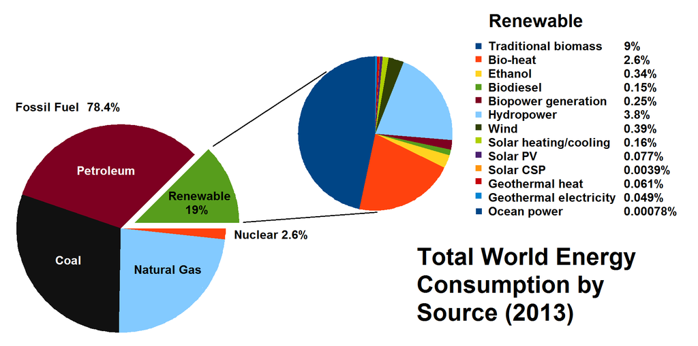

Slide 12
Renewable energy resources and significant opportunities for energy efficiency exist over wide geographical areas, in contrast to other energy sources, which are concentrated in a limited number of countries. Rapid deployment of renewable energy and energy efficiency, and technological diversification of energy sources, would result in significant energy security and economic benefits. It would also reduce environmental pollution such as air pollution caused by burning of fossil fuels and improve public health, reduce premature mortalities due to pollution and save associated health costs that amount to several hundred billion dollars annually only in the United States. Renewable energy sources, that derive their energy from the sun, either directly or indirectly, such as hydro and wind, are expected to be capable of supplying humanity energy for almost another 1 billion years, at which point the predicted increase in heat from the sun is expected to make the surface of the earth too hot for liquid water to exist.
Climate change and global warming concerns, coupled with high oil prices, peak oil, and increasing government support, are driving increasing renewable energy legislation, incentives and commercialization. New government spending, regulation and policies helped the industry weather the global financial crisis better than many other sectors. According to a 2011 projection by the International Energy Agency, solar power generators may produce most of the world's electricity within 50 years, reducing the emissions of greenhouse gases that harm the environment.

Slide 13
As of 2011, small solar PV systems provide electricity to a few million households, and micro-hydro configured into mini-grids serves many more. Over 44 million households use biogas made in household-scale digesters for lighting and/or cooking, and more than 166 million households rely on a new generation of more-efficient biomass cookstoves.^{[31]} United Nations' Secretary-General Ban Ki-moon has said that renewable energy has the ability to lift the poorest nations to new levels of prosperity.^{[18]} At the national level, at least 30 nations around the world already have renewable energy contributing more than 20% of energy supply. National renewable energy markets are projected to continue to grow strongly in the coming decade and beyond, and some 120 countries have various policy targets for longer-term shares of renewable energy, including a 20% target of all electricity generated for the European Union by 2020. Some countries have much higher long-term policy targets of up to 100% renewables. Outside Europe, a diverse group of 20 or more other countries target renewable energy shares in the 2020–2030 time frame that range from 10% to 50%. ^{[32]}

Slide 15
Renewable energy often displaces conventional fuels in four areas: electricity generation, hot water/space heating, transportation, and rural (off-grid) energy services:[4]
Power generation
By 2040, renewable energy is projected to equal coal and natural gas electricity generation. Several jurisdictions, including Denmark, Germany, the state of South Australia and some US states have achieved high integration of variable renewables. For example, in 2015 wind power met 42% of electricity demand in Denmark, 23.2% in Portugal and 15.5% in Uruguay. Interconnectors enable countries to balance electricity systems by allowing the import and export of renewable energy. Innovative hybrid systems have emerged between countries and regions.
Heating
Solar water heating makes an important contribution to renewable heat in many countries, most notably in China, which now has 70% of the global total (180 GWth). Most of these systems are installed on multi-family apartment buildings and meet a portion of the hot water needs of an estimated 50–60 million households in China. Worldwide, total installed solar water heating systems meet a portion of the water heating needs of over 70 million households. The use of biomass for heating continues to grow as well. In Sweden, national use of biomass energy has surpassed that of oil. Direct geothermal for heating is also growing rapidly.[34] The newest addition to Heating is from Geothermal Heat Pumps which provide both heating and cooling, and also flatten the electric demand curve and are thus an increasing national priority[35][36] (see also Renewable thermal energy).

Slide 16
Transportation
A bus fueled by biodiesel
Bioethanol is an alcohol made by fermentation, mostly from carbohydrates produced in sugar or starch crops such as corn, sugarcane, or sweet sorghum. Cellulosic biomass, derived from non-food sources such as trees and grasses is also being developed as a feedstock for ethanol production. Ethanol can be used as a fuel for vehicles in its pure form, but it is usually used as a gasoline additive to increase octane and improve vehicle emissions. Bioethanol is widely used in the USA and in Brazil. Biodiesel can be used as a fuel for vehicles in its pure form, but it is usually used as a diesel additive to reduce levels of particulates, carbon monoxide, and hydrocarbons from diesel-powered vehicles. Biodiesel is produced from oils or fats using transesterification and is the most common biofuel in Europe.
A solar vehicle is an electric vehicle powered completely or significantly by direct solar energy. Usually, photovoltaic (PV) cells contained in solar panels convert the sun's energy directly into electric energy. The term "solar vehicle" usually implies that solar energy is used to power all or part of a vehicle's propulsion. Solar power may be also used to provide power for communications or controls or other auxiliary functions. Solar vehicles are not sold as practical day-to-day transportation devices at present, but are primarily demonstration vehicles and engineering exercises, often sponsored by government agencies. High-profile examples include PlanetSolar and Solar Impulse. However, indirectly solar-charged vehicles are widespread and solar boats are available commercially.

Slide 17
History
Prior to the development of coal in the mid 19th century, nearly all energy used was renewable. Almost without a doubt the oldest known use of renewable energy, in the form of traditional biomass to fuel fires, dates from 790,000 years ago. Use of biomass for fire did not become commonplace until many hundreds of thousands of years later, sometime between 200,000 and 400,000 years ago. Probably the second oldest usage of renewable energy is harnessing the wind in order to drive ships over water. This practice can be traced back some 7000 years, to ships in the Persian Gulf and on the Nile. Moving into the time of recorded history, the primary sources of traditional renewable energy were human labor, animal power, water power, wind, in grain crushing windmills, and firewood, a traditional biomass. A graph of energy use in the United States up until 1900 shows oil and natural gas with about the same importance in 1900 as wind and solar played in 2010.

Slide 18
In the 1860s and 1870s there were already fears that civilization would run out of fossil fuels and the need was felt for a better source. In 1873 Professor Augustin Mouchot wrote:
The time will arrive when the industry of Europe will cease to find those natural resources, so necessary for it. Petroleum springs and coal mines are not inexhaustible but are rapidly diminishing in many places. Will man, then, return to the power of water and wind? Or will he emigrate where the most powerful source of heat sends its rays to all? History will show what will come.
In 1885, Werner von Siemens, commenting on the discovery of the photovoltaic effect in the solid state, wrote:
In conclusion, I would say that however great the scientific importance of this discovery may be, its practical value will be no less obvious when we reflect that the supply of solar energy is both without limit and without cost, and that it will continue to pour down upon us for countless ages after all the coal deposits of the earth have been exhausted and forgotten.
Max Weber mentioned the end of fossil fuel in the concluding paragraphs of his Die protestantische Ethik und der Geist des Kapitalismus, published in 1905.
Development of solar engines continued until the outbreak of World War I. The importance of solar energy was recognized in a 1911 Scientific American article: "in the far distant future, natural fuels having been exhausted [solar power] will remain as the only means of existence of the human race".
The theory of peak oil was published in 1956. In the 1970s environmentalists promoted the development of renewable energy both as a replacement for the eventual depletion of oil, as well as for an escape from dependence on oil, and the first electricity generating wind turbines appeared. Solar had long been used for heating and cooling, but solar panels were too costly to build solar farms until 1980.

Slide 19
Tendency to invest in Renewable energy

Slide 20
Mainstream Technologies: 1- Wind Power
In 2017, worldwide installed capacity of wind power was 514 GW
Airflows can be used to run wind turbines. Modern utility-scale wind turbines range from around 600 kW to 9 MW of rated power. The power available from the wind is a function of the cube of the wind speed, so as wind speed increases, power output increases up to the maximum output for the particular turbine. Areas where winds are stronger and more constant, such as offshore and high altitude sites, are preferred locations for wind farms. Typically full load hours of wind turbines vary between 16 and 57 percent annually, but might be higher in particularly favorable offshore sites.
Wind-generated electricity met nearly 4% of global electricity demand in 2015, with nearly 63 GW of new wind power capacity installed. Wind energy was the leading source of new capacity in Europe, the US and Canada, and the second largest in China. In Denmark, wind energy met more than 40% of its electricity demand while Ireland, Portugal and Spain each met nearly 20%.
Globally, the long-term technical potential of wind energy is believed to be five times total current global energy production, or 40 times current electricity demand, assuming all practical barriers needed were overcome. This would require wind turbines to be installed over large areas, particularly in areas of higher wind resources, such as offshore. As offshore wind speeds average ~90% greater than that of land, so offshore resources can contribute substantially more energy than land stationed turbines.

Slide 21
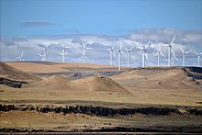
The 845 MW Shepherds Flat Wind Farm near Arlington, Oregon, US

Slide 22
Hydropower and Hydroelectricity
In 2017 the World renewable hydropower capacity was 1,154 GW
Since water is about 800 times denser than air, even a slow flowing stream of water, or moderate sea swell, can yield considerable amounts of energy. There are many forms of water energy:
Historically hydroelectric power came from constructing large hydroelectric dams and reservoirs, which are still popular in third world countries. The largest of which is the Three Gorges Dam(2003) in China and the Itaipu Dam(1984) built by Brazil and Paraguay.
Small hydro systems are hydroelectric power installations that typically produce up to 50 MW of power. They are often used on small rivers or as a low impact development on larger rivers. China is the largest producer of hydroelectricity in the world and has more than 45,000 small hydro installations.
Run-of-the-river hydroelectricity plants derive energy from rivers without the creation of a large reservoir. The water is typically conveyed along the side of the river valley (using channels, pipes and/or tunnels) until it is high above the valley floor, whereupon it can allowed to fall through a penstock to drive a turbine. This style of generation may still produce a large amount of electricity, such as the Chief Joseph Dam on the Columbia river in the United States.
Hydropower is produced in 150 countries, with the Asia-Pacific region generating 32 percent of global hydropower in 2010. For countries having the largest percentage of electricity from renewables, the top 50 are primarily hydroelectric. China is the largest hydroelectricity producer, with 721 terawatt-hours of production in 2010, representing around 17 percent of domestic electricity use. There are now three hydroelectricity stations larger than 10 GW: the Three Gorges Dam in China, Itaipu Dam across the Brazil/Paraguay border, and Guri Dam in Venezuela.

Slide 23
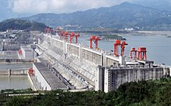
~ 12 GW, The Three Gorges Dam on the Yangtze River in China

Slide 24
Wave-power
Wave power, which captures the energy of ocean surface waves, and tidal power, converting the energy of tides, are two forms of hydropower with future potential; however, they are not yet widely employed commercially. A demonstration project operated by the Ocean Renewable Power Company on the coast of Maine, and connected to the grid, harnesses tidal power from the Bay of Fundy, location of world's highest tidal flow. Ocean thermal energy conversion, which uses the temperature difference between cooler deep and warmer surface waters, currently has no economic feasibility.

Slide 25
Solar Energy
Satellite image of the 550-megawatt Topaz Solar Farm in California, US
In 2017, global installed solar capacity was 390 GW.
Solar energy, radiant light and heat from the sun, is harnessed using a range of ever-evolving technologies such as solar heating, photovoltaics, concentrated solar power (CSP), concentrator photovoltaics (CPV), solar architecture and artificial photosynthesis. Solar technologies are broadly characterized as either passive solar or active solar depending on the way they capture, convert and distribute solar energy. Passive solar techniques include orienting a building to the Sun, selecting materials with favorable thermal mass or light dispersing properties, and designing spaces that naturally circulate air. Active solar technologies encompass solar thermal energy, using solar collectors for heating, and solar power, converting sunlight into electricity either directly using photovoltaics (PV), or indirectly using concentrated solar power (CSP).

Slide 26
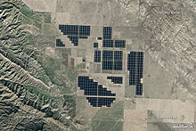
Satellite image of the 550-megawatt Topaz Solar Farm in California, US

Slide 27
PV-Photovoltaic
A photovoltaic system converts light into electrical direct current (DC) by taking advantage of the photoelectric effect.[53] Solar PV has turned into a multi-billion, fast-growing industry, continues to improve its cost-effectiveness, and has the most potential of any renewable technologies together with CSP. Concentrated solar power (CSP) systems use lenses or mirrors and tracking systems to focus a large area of sunlight into a small beam. Commercial concentrated solar power plants were first developed in the 1980s. CSP-Stirling has by far the highest efficiency among all solar energy technologies.
In 2011, the International Energy Agency said that "the development of affordable, inexhaustible and clean solar energy technologies will have huge longer-term benefits. It will increase countries' energy security through reliance on an indigenous, inexhaustible and mostly import-independent resource, enhance sustainability, reduce pollution, lower the costs of mitigating climate change, and keep fossil fuel prices lower than otherwise. These advantages are global. Hence the additional costs of the incentives for early deployment should be considered learning investments; they must be wisely spent and need to be widely shared".

Slide 28
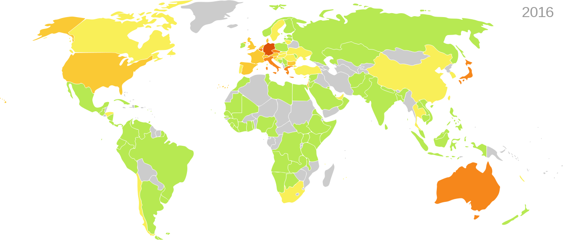
Worldwide installed photovoltaic capacity in "watts per capita" by country. Estimated 2016: Grey none or unknown green <10 watts per inhabitant yellow 10–100 watts per inhabitant yl-or 100–200 watts per inhabitant Orange 200–400 watts per inhabitant red >400 watts per inhabitant

Slide 29
Geothermal Energy
Steam rising from the Nesjavellir Geothermal Power Station in Iceland
Global geothermal capacity in 2017 was 12.9 GW.
High Temperature Geothermal energy is from thermal energy generated and stored in the Earth. Thermal energy is the energy that determines the temperature of matter. Earth's geothermal energy originates from the original formation of the planet and from radioactive decay of minerals (in currently uncertain but possibly roughly equal proportions). The geothermal gradient, which is the difference in temperature between the core of the planet and its surface, drives a continuous conduction of thermal energy in the form of heat from the core to the surface. The adjective geothermal originates from the Greek roots geo, meaning earth, and thermos, meaning heat.
The heat that is used for geothermal energy can be from deep within the Earth, all the way down to Earth's core – 4,000 miles (6,400 km) down. At the core, temperatures may reach over 9,000 °F (5,000 °C). Heat conducts from the core to surrounding rock. Extremely high temperature and pressure cause some rock to melt, which is commonly known as magma. Magma convects upward since it is lighter than the solid rock. This magma then heats rock and water in the crust, sometimes up to 700 °F (371 °C).

Slide 30
Biomass energy
Sugarcane plantation to produce ethanol in Brazil
A CHP power station using wood to supply 30,000 households in France
Bioenergy global capacity in 2017 was 109 GW.
Biomass is biological material derived from living, or recently living organisms. It most often refers to plants or plant-derived materials which are specifically called lignocellulosic biomass. As an energy source, biomass can either be used directly via combustion to produce heat, or indirectly after converting it to various forms of biofuel. Conversion of biomass to biofuel can be achieved by different methods which are broadly classified into: thermal, chemical, and biochemical methods. Wood remains the largest biomass energy source today; examples include forest residues – such as dead trees, branches and tree stumps –, yard clippings, wood chips and even municipal solid waste. In the second sense, biomass includes plant or animal matter that can be converted into fibers or other industrial chemicals, including biofuels. Industrial biomass can be grown from numerous types of plants, including miscanthus, switchgrass, hemp, corn, poplar, willow, sorghum, sugarcane, bamboo, and a variety of tree species, ranging from eucalyptus to oil palm (palm oil).
Biomass can be converted to other usable forms of energy such as methane gas or transportation fuels such as ethanol and biodiesel. Rotting garbage, and agricultural and human waste, all release methane gas – also called landfill gas or biogas. Crops, such as corn and sugarcane, can be fermented to produce the transportation fuel, ethanol. Biodiesel, another transportation fuel, can be produced from left-over food products such as vegetable oils and animal fats.

Slide 31
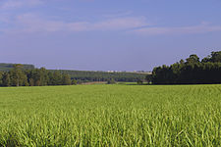
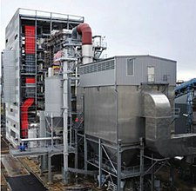
Sugarcane plantation to produce ethanol in Brazil
A CHP power station using wood to supply 30,000 households in France

Slide 32
Energy storage
Energy storage is a collection of methods used to store electrical energy on an electrical power grid, or off it. Electrical energy is stored during times when production (especially from intermittent power plants such as renewable electricity sources such as wind power, tidal power, solar power) exceeds consumption, and returned to the grid when production falls below consumption. Pumped-storage hydroelectricity is used for more than 90% of all grid power storage. Costs of lithium ion batteries are dropping rapidly, and are increasingly being deployed as fast acting sources of grid power (i.e. operating reserve) and for domestic storage.

Slide 33
Worldwide installed photovoltaic capacity in "watts per capita" by country. Estimated 2016: Grey none or unknown green <10 watts per inhabitant yellow 10–100 watts per inhabitant yl-or 100–200 watts per inhabitant Orange 200–400 watts per inhabitant red >400 watts per inhabitant

Slide 34
